Slide 1
WSMP, PSID, Port Numbers, and “Re-entrant” applications
John Moring
September 2012

Slide 2
Problem statement
It has been suggested that PSIDs are inadequate to support the situation where multiple distinct applications, running on the same device, communicate with an application running on a remote device
unicast
App1
App
unicast
App2

Slide 3
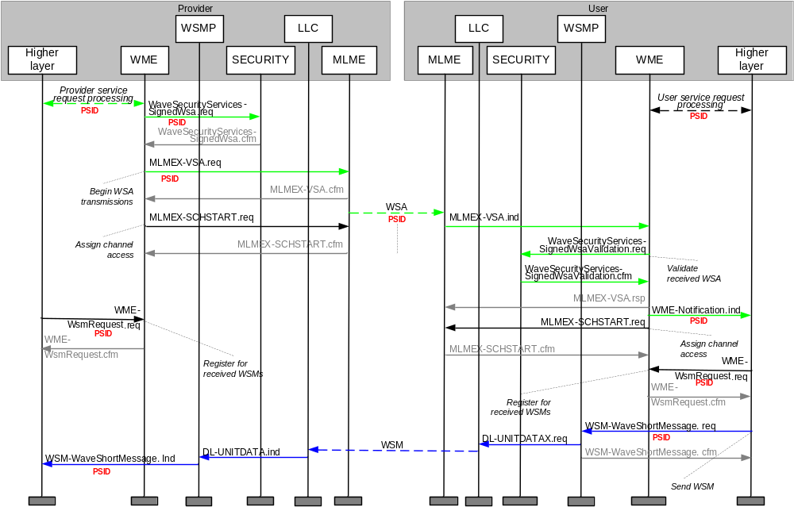
Service setup & WSM delivery

Slide 4
WSM delivery on receipt
WSMs are delivered to higher layer entities (HLE) within a station based on the PSID(s) for which the HLE has registered
App1
App2
- - -
AppN
WSM(psidA),
WSM(psidB)
WSM(psidC)
WSM(psidA),
WSM(psidB),
WSM(psidD)
WSMP

Slide 5
Scenarios
Provider
User
broadcast
APP
App
No problem; no ambiguity
unicast
broadcast
APP
App
No problem;
destination is distinguished
by MAC address
unicast
unicast
App
broadcast
APP
App1
No problem;
each app gets all broadcast data
App2
unicast
App1
Potential problem;
How does APP distinguish between
traffic to/from App1 & App2
running in the same device?
APP
unicast
App2

Slide 6
Solution 1: Session ID
Applications needing such a feature could include a session identifier in their messages at the application layer

Slide 7
Solution 2: Dynamic Ports
TCP/UDP (for example) uses a range of port numbers for dynamic assignment to a particular session
  RFC 6335 allocates the range 49,152 to 65,535 to Dynamic (or Private or Ephemeral) ports
    In addition to System (or Well Known) ports (0-1023) and User (or Registered) ports (1024-49151)
A similar approach is taken with the port numbers used in ISO Fast Network Transport Protocol (FNTP) [ISO 29281-1]
A similar approach could be taken for PSID, with a predefined range of dynamic PSID values

Slide 8
Solution 3: Extended Private PSIDs
Application developers needing such a feature could acquire multiple PSID values to be used when needed, e.g.,
  Assigned psidN is used for advertisements and as the default communication PSID (as today)
  Assigned psidN+1 is used as the communication PSID for the second unicast application running on a device
  And so on

Slide 9
Summary
Session ID
  Supported by 1609 today
Dynamic Ports
  WSMP could be extended to support port numbers
  1609 could be extended to support dynamic PSIDs
    Allocate range of dynamic values
    Specify local WME SAP calls: get PSID/release PSID
  WSMP could be replaced with FNTP
  1609 could be extended to incorporate FNTP as well as WSMP
Extended Private PSIDs
  Supported by 1609 today

Slide 10
1609 potential actions
No action at present
Build port numbers into WSMP
Allocate a range of PSID values for dynamic assignment
  With or without explicit support in WSMP
Draft guidance to developers, e.g., in 1609.0
Add FNTP to 1609 (by reference)
  Remove WSMP or not

